Slide 1

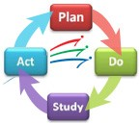
ACPS Strategic Improvement Plan
Summary Report
December 11, 2014
Charlie Price, Strategic Planning & Organizational Improvement

Slide 2
Division Strategic Improvement Plan
(Board Priorities) Reporting Cycle
Summary Report - December
  High level progress summary
  Majority of Performance Indicators are end of year data
  For Information and feedback
Comprehensive Report - June
  Detailed progress analysis
  Mix of current and end of prior year data
  For Information and Action

Slide 3
MISSION
​The core purpose of
Albemarle County Public Schools
is to establish a community
of learners and learning,
through relationships,
relevance and rigor,
one student at a time.
VALUES
Excellence
Young People
Community
Respect
VISION
All learners believe
in their power
to embrace learning,
to excel, and
to own their future.
OBJECTIVES
1|Engage every student.
2|Implement balanced assessments.
3|Improve opportunity and achievement.
4|Create and expand partnerships.
5|Optimize resources.
Horizon 2020 Strategic Plan
2013-2020
Notes:
Division’s Foundation for getting all our arrows pointing in the same direction.

Slide 4
ONE Student-Centered GOAL
  All Albemarle County Public Schools students will graduate having actively mastered the lifelong-learner skills they need to succeed as 21st century learners, workers and citizens.

Slide 5
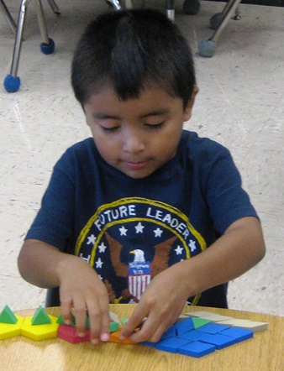
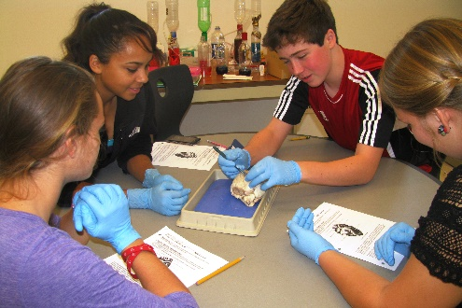
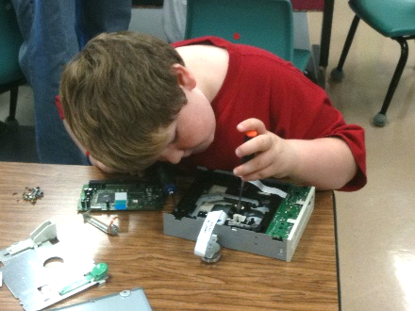
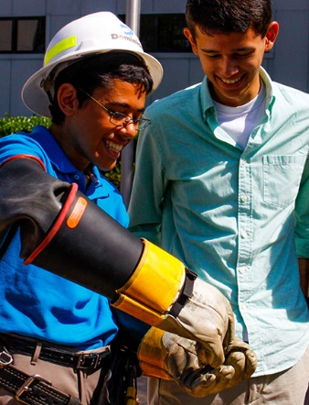
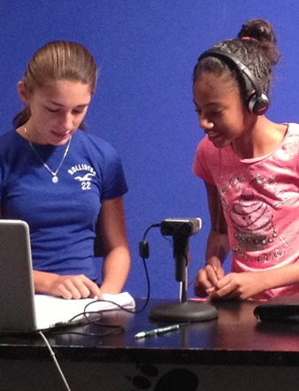
Engage Every Student
Balanced Assessments
Opportunity & Achievement
Partnerships
Optimize Resources
Effective Teaching Practices
Professional Development
Contemporary Learning Spaces
Performance-Based Assessments for LLC
Transitions
World Language Program
Work Based Learning & Field Trips
Community Support
School Community Health/Safety
Optimize Fiscal Resources
High School
of the Future
Division Strategic Improvement Plan
Notes:
One student centered Goal
Five Objectives we commit to that will support achieving our Goal.
Twelve Priorities to focus our Division wide Strategic Improvement Plan to achieve our Goal.
School and Department SIPs support the Division SIP
These plans are not all inclusive . . . We do so much more
These plans are high target areas.

Slide 6
⑤ Transformation/Innovation
Strong evidence exists that the division has implemented the core of its vision, goal, and this priority. Evidence exists to show that the Division is experiencing a demonstrable change in paradigm and outcomes as a result of this priority.
④ Integration
Considerable evidence exists for attention to the priority both in terms of outputs for teaching and learning and for operations. Implementation of the division’s vision through purposeful, systemic implementation of this priority is well documented.
③ Application
Considerable evidence of attention exists for this priority, particularly in the area of planning. There appears to be a foundation of broad implementation and execution through inputs that will impact outcomes for teaching, learning, and operations.
② Development
Adequate evidence of attention exists for this priority, particularly in the area of planning. There appears to be a foundation of variable implementation and execution through inputs that will impact outcomes.
① Absence
Evidence does not exist to indicate systemic attention to planning or execution for this priority across the Division that will impact outcomes for teaching, learning, and operations.
Impact Rubric

Slide 7

Wow Factor = 5
Ensure that every student is taking advantage of the opportunities provided?
Support students to own their own learning?
Provide equitable opportunities to all students?
Capitalize on the talents of the ACPS Community to support student mastery of Lifelong Learning Competencies?
Create experiences that are both memorable and valuable?
Learning Opportunities = enriched experiences, resource accessibility, teaching excellence, community partnerships.
Notes:
Learning Opportunities = enriched experiences, resource accessibility, teaching excellence, community partnerships.
Within this deceptively simple phrase each word plays a powerful role in spurring creative problem-solving.
“How” assumes that solutions exist and provides the creative confidence needed to identify and solve for unmet needs.
“Might” says that we can put ideas out there that might work or might not—either way, we’ll learn something useful.
“We” signals that we’re going to collaborate and build on each other’s ideas to find creative solutions together.

Slide 8
Division SIP Assignments
* School Board Assessment, July 2014
Objective | Priority | Champion | Leads | Impact Score*
Engage Every Student | 1.1 Effective Teaching Practices | Matt Haas | Ira Socol Michael Craddock Clare Kaiser Becky Fisher | 3
 | 1.2 Professional Development | Debbie Collins | Becky Fisher Cyndi Wells Clare Kaiser | 3
 | 1.3 Contemporary Learning Spaces | Dean Tistadt | Vince Scheivert Joe Letteri | 2
Implement Balanced Assessments | 2.1 Performance-Based Assessments | Debbie Collins | Vince Scheivert Jennifer Sublette-Williamson | 2
Opportunity & Achievement | 3.1 Transitions | Matt Haas | Keri O’Connor | 2
 | 3.2 World Language Program | Debbie Collins | Rusty Carlock | Work Session
Partnerships | 4.1 Work Based Learning & Field Trips | Matt Haas | Chad Ratliff | 2
 | 4.2 Community Support | Dean Tistadt | Phil Giaramita Nicole Storm | 2
Optimize Resources | 5.1 School Community Health/Safety | Dean Tistadt | Cabell Guy Joe Letteri Eileen Gomez Lorna Gerome Leanne Knox | 4
 | 5.2 Optimize Fiscal Resources | Dean Tistadt | Jackson Zimmerman William Dean | 3
 | 5.3 High School of the Future | Dean Tistadt | Jay Thomas | Work Session

Slide 9
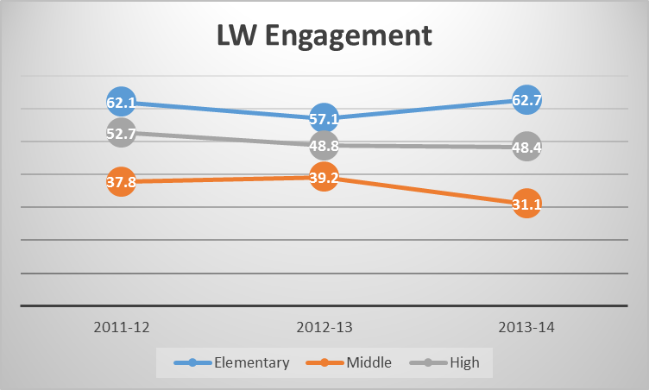
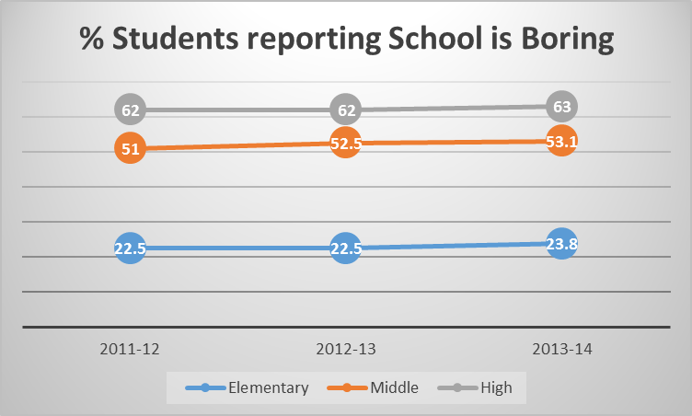
Engage Every Student
1.1 Define, develop, and implement effective teaching practices that maximize rigor and meaningful engagement for all students.
M. Haas
Summary of Strategies / Actions
  1.1.1 Establish Innovation Team to spearhead piloting and evaluation of innovative and effective educational practice.
  Completed 9 initiatives (Priority 1.3):
    Library Music Studios at MHS, AHS, and SMS
    Flex Space and Project Garage at AHS
    Contemporary Science Suite at SMS
    CTE Space updates at HMS and WMS
    2nd Maker Space at MHS
  Initiated Merged Classroom design effort at WMS
1.1.2 Identify and create quality digital learning resources.
Initiated the Digital Learning Project (DLP)
Established a central system where digital learning resources are accesses.
Established feedback mechanism to rate digital learning resources.
Analysis of Performance Indicators
  The percent of students reporting school is boring has remained relatively flat.
  Only elementary school students have shown an increase in Engagement (Learning Walk Observation)
  Use of digital resources in secondary schools have increased since initiating the Digital Learning Project
Next Steps
  Establish maintenance / curation protocols for DLP with Teachers & Lead Coaches
  Hold Work Sessions with teachers around using and contributing to DLP
  Plan for Summer / Fall DLP PD sessions
July ‘14 Impact Assessment Score: 3
Notes:
The digital learning project is the next important step in Albemarle County's design efforts to identify and create quality digital learning resources for our middle and high school students. The use of these resources will extend the continuum of learning opportunities available to students, providing learners with a variety of tools to accomplish their work.
The digital learning project took shape in 2014 with two goals in mind:
1. Select, organize, and deliver the best digital learning resources.
2. Provide examples for teachers on how to leverage digital resources in their classroom.
As the project evolved additional milestones were reached:
1. Provide a feedback mechanism where stakeholders can rate digital learning resources.
2. Establish a system where teachers can continue to contribute digital learning resources throughout the school year.

Slide 10
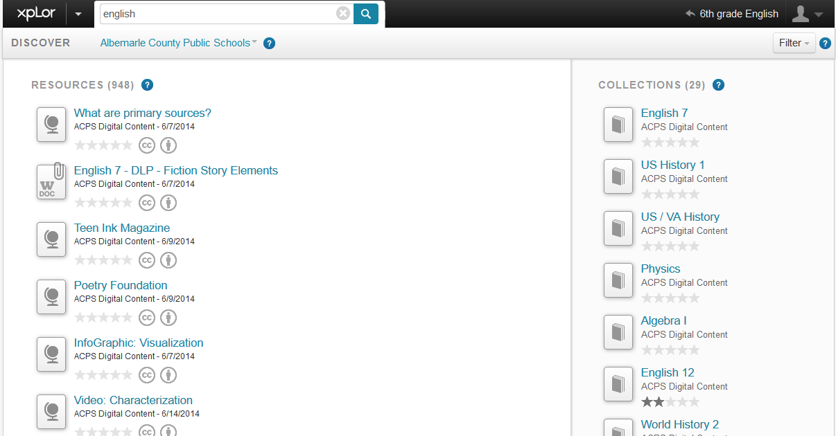
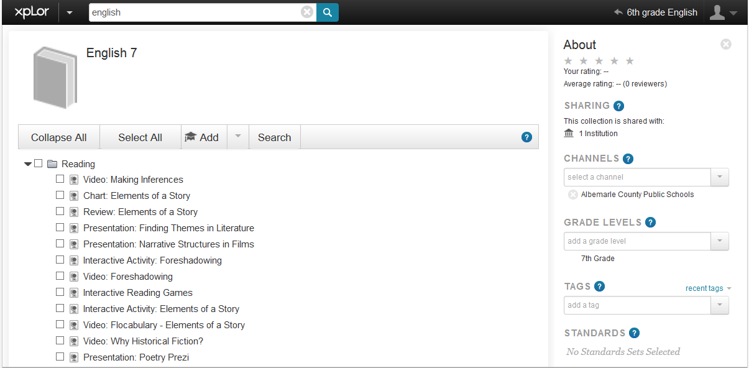
Blackboard DLP Resources

Slide 11
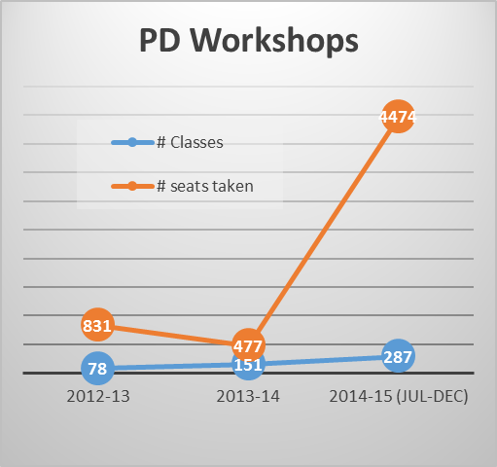
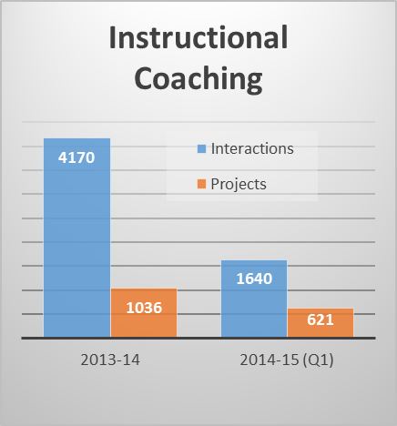
Engage Every Student
1.2 Develop a division-wide master framework or contemporary professional development and training that optimizes our workforce and addresses the essential competencies needed by teachers, administrators, and classified staff.
D. Collins
Summary of Strategies / Actions
  1.2.1 Internal PD Management Organization
Co-creation of PD workshops for teachers by all departments (Instruction, Special Education, Technology, Community Engagement)
Delivery of summer PD for integration of digital resources into secondary classrooms
Delivery of summer PD for integration of technology tools into elementary classrooms
Delivery of PD focused on Seven Pathways
Development of PD Opportunities in the areas of mathematics and PLC
Delivery of increased number of PD Opportunities developed for ACPS
  Delivery of PD for use of competency-based learning and performance assessments.
  1.2.2 Include digital portfolios for licensed staff in performance appraisal system
Analysis of Performance Indicators
  Both PD Workshop attendance and utilization of the Instructional Coaching model have drastically increased.
  PD Workshop attendance has already tripled last years numbers and it is only mid-year.
  At the current rate the Instructional Coaching projects are projected to exceed last year by almost 900.
Next Steps
  Complete annual PD “Needs Assessment”
  Create ACPS Opportunities based on Needs Assessment.
  Complete development of the Office of Instruction Improvement Plan focused on PD & Effective Teaching Practices
July ‘14 Impact Assessment Score: 3

Slide 12
Engage Every Student
1.3 Integrate the use of Contemporary Learning Space & Instructional Technologies into the instructional program delivery.
D. Tistadt
Summary of Strategies / Actions
  1.3.1 Convert spaces to contemporary learning space standards.
  Completed current state assessment of all schools.
  10 year plan submitted to the School Board and CIP process.
  1.3.2 Implement a 1:1 Student Technology Ratio
Analysis of Performance Indicators
  Contemporary Learning Spaces Evaluation Report 08/07/14 – Baseline Data
Next Steps
  Complete evaluations on all Design 2015 projects.
  Monitor CIP process; be ready to act upon approval.
July ‘14 Impact Assessment Score: 2

Slide 13
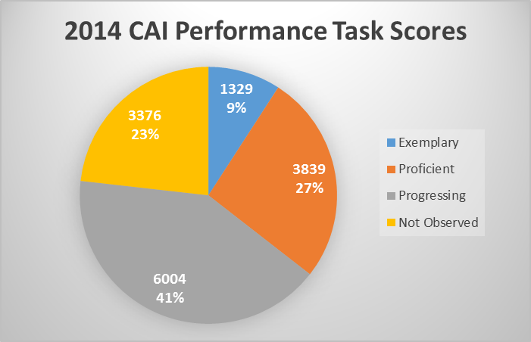
Balanced Assessments
2.1 Define, Communicate, and Implement the Division’s specific measures (Performance Based Tasks) for mastery of lifelong-learning competencies and student success.
D. Collins
Summary of Strategies / Actions
  2.1.1 Define and communicate Division Performance Based Tasks. - COMPLETE
  Rubrics have been developed for the lifelong-learning competencies and initial training has been provided (CAI2014)
  2.1.2 Implement Performance Based Tasks.
  Drafted student portfolios elements / expectations / procedures.
  Prototype student portfolio containers have been developed for each grade level.
Analysis of Performance Indicators
  14,548 unique pieces of work
  Across all grade levels
  Keyed to 8 different Lifelong Learning Competencies
  36% scored Proficient or better
Next Steps
  Create School Level Report by LLC
  Expand Performance Tasks Library
  Expand PD opportunities (Priority 1.2)
  Develop and implement school scoring teams
July ‘14 Impact Assessment Score: 2

Slide 14
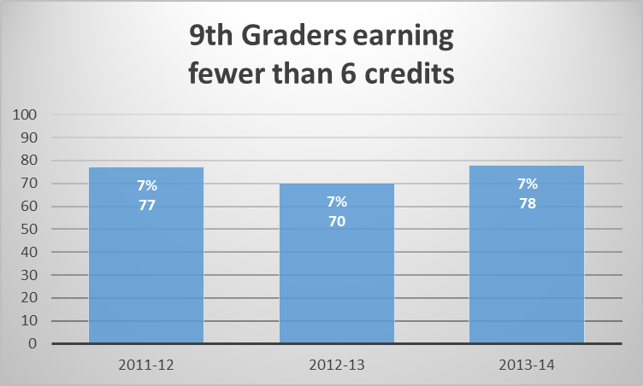
Opportunity & Achievement
3.1 Prepare all students for successful Transitions to the next grade in their PK-12 experience.
M. Haas
Summary of Strategies / Actions
  Integrated team of school counselors, Intervention specialists, and community engagement have been formed.
  3.1.1 Create and implement a standard transition activity plan for elementary to middle and middle to high school transitions.
  Current state assessment was completed to capture best practices in Middle and High School Transition activities.
    Results are being analyzed to capture best practice and suggested improvements.
  3.1.2 Identify and mitigate barriers to successful grade transitions.
  Initiating discussions around student stress levels and support opportunities.
  Administered survey concerning effectiveness of Summer Assignments in High School.
  Administered survey on 9th grade Transition experience.
Analysis of Performance Indicators
  60% of Survey respondents indicated that they participated in a 9th grade Transition program. Of those 60% only 37% indicated that the program helped them prepare for high school.
  The implementation of more rigorous high school transition activities may help reduce the number of 9th graders not earning 6+ credits.
Next Steps
  Establish Elem/Middle and Middle/High standard transition activities based on current best practices.
  Analyze Summer Assignment effectiveness and provide recommendations.
  Review Safe Schools / Healthy Students grant to identify the most effective practices to continue. (Priority 5.1)
July ‘14 Impact Assessment Score: 2

Slide 15
Opportunity & Achievement
3.2 Implement a robust, Division-wide PK-12 World Languages program.
D. Collins
Summary of Strategies / Actions
  3.2.1 Develop a proposal / plan.
  Pilot Program in Spanish established at Cale Elementary School. Currently K-2 with expansion to 5th grade by the 2017-18 SY.
  Board re-defined what constituted a “robust” program during the October Work Session as one that begins in preschool or kindergarten and continues through middle school using immersion programs whenever possible and supplementing with pull-out programs.
World Languages initiatives in elementary schools in recent years
School | Initiative
Agnor-Hurt | Kindergarten Spanish with TA
Baker Butler | Volunteer parents Spanish classes
Brownsville | After School Program
Cale | Pull-out and Immersion K-2
Meriwether Lewis | After School Program
Murray | Rosetta Stone
Stony Point | Kindergarten Spanish
Analysis of Performance Indicators
  Performance Indicators will be baselined following approval of revised implementation plan.
Next Steps
  Provide updated Plan to School Board – Dec 11
Board Work Session

Slide 16
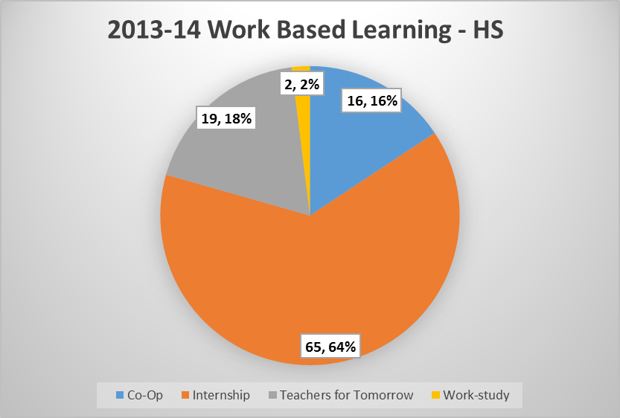
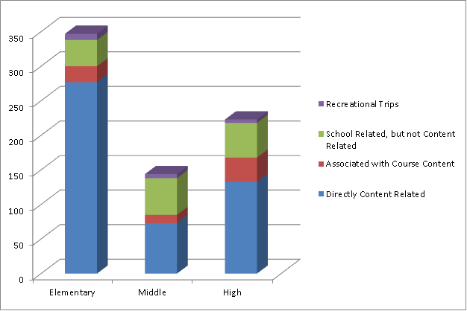
Partnerships
4.1 Implement a comprehensive Work Based Learning program and expand
Field Trip opportunities to provide real-world learning experiences for all
students.
M. Haas
Summary of Strategies / Actions
  Revised strategies and actions based on School Board feedback and VDOE initiatives.
  4.1.1 Align ACPS Mentorship/Internship Program with the VDOE Work Based Learning (WBL) program.
  Currently in the planning phase of aligning with the VDOE WBL program in terms of documentation, definitions, and education. WBL website being developed.
  Work Based Learning is a broader definition that includes opportunities like co-op, work-study, etc.
  Summer 2015 will be the baseline collection of comprehensive Work Based Learning experiences including Internships
  4.1.2 Establish a standard concept for Field Trip experiences by grade level.
  Baseline data has been collected concerning # and types of field trip opportunities that occurred during the 2013-14 School Year.
Analysis of Performance Indicators
  Performance indicators for both WBL and Field Trips are input indicators in order to establish a baseline and provide a foundation for improvement planning.
Next Steps
  Publish WBL website and execute training program for teachers & administrators.
  Form an interdisciplinary team to analyze the Field Trip data to identify opportunities for improvement.
  Establish standard Field Trip concept for K-3.
July ‘14 Impact Assessment Score: 2
Notes:
Work-based learning is a school-coordinated, coherent sequence of workplace experiences that are related to students’ career goals and/or interests, are based on instructional preparation, and are performed in partnership with local businesses, industries, or other organizations in the community. WBL enables students to apply classroom instruction in a real-world business or service-oriented work environment. The seven WBL methods of instruction are (from the lowest to the highest degree of engagement): job shadowing, mentorship, service learning, internship, clinical experience, student apprenticeship, cooperative education.
An analysis was performed of 714 field trips that occurred in ACPS during the 2013-2014 school year. This does not include athletic trips, special routes used for tutoring arrangements, and other supplemental transportation. Trips were categorized by type of school (elementary, middle, high) and by the type of trip that was taken (directly related to course content; associated with course content; school related, but not content related; and recreational trips). Examples of trips that are school related but not content related might be elementary students visiting middle schools. Recreational trips might include rewards for reaching class goals and class trips, such as taking fifth graders to a park to celebrate their elementary school achievements. Of the 714 trips that were analyzed, 347 occurred at elementary schools, 144 occurred at middle schools, and 223 occurred at high schools.

Slide 17
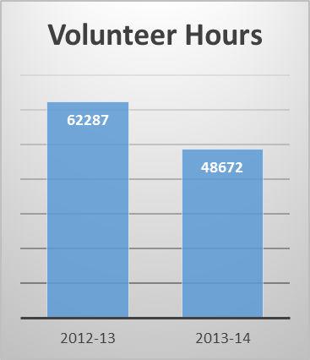
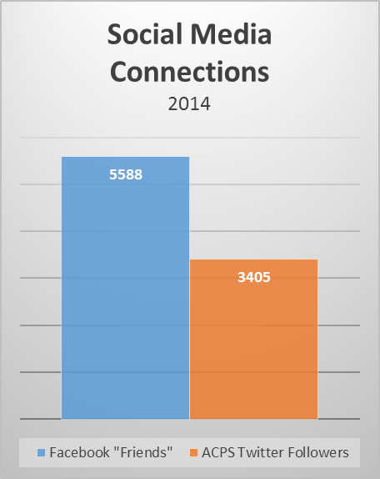
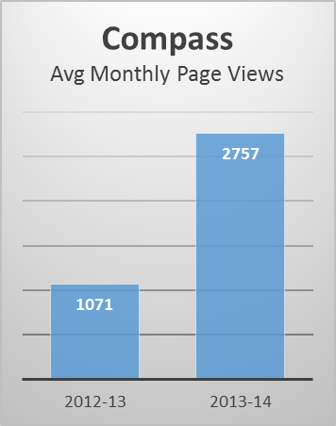
Partnerships
4.2 Invest the full Community in supporting student achievement and outcomes for all students’ success.
D. Tistadt
Summary of Strategies / Actions
  4.2.1 Enhance Communication with ACPS Community
Redesigned employee newsletter (Compass) to increase internal community engagement.
Implemented live streaming of School board work sessions to increase external community engagement.
Joint work with Board of Supervisors to develop budget documentation that anyone can see the line of sight through.
  4.2.2 Establish a survey calendar to gather feedback from all stakeholder groups.
  Identified all current Division level surveys being administered throughout the year.
Analysis of Performance Indicators
  Need to verify fidelity of Volunteer Hour data collection at each school.
  Compass readership has more than doubled since implementing the redesign.
Next Steps
  Climate Survey workgroup revising survey questions to capture key components from Safe Schools Healthy Students grant. (in conjunction with Priority 3.1 and 5.1)
  Redesign / update School Board Home Page
  Implement text messaging feature in our current Bb Connect notification system for students, parents, and staff.
  Initiate School Website & Portfolio development project.
July ‘14 Impact Assessment Score: 2

Slide 18
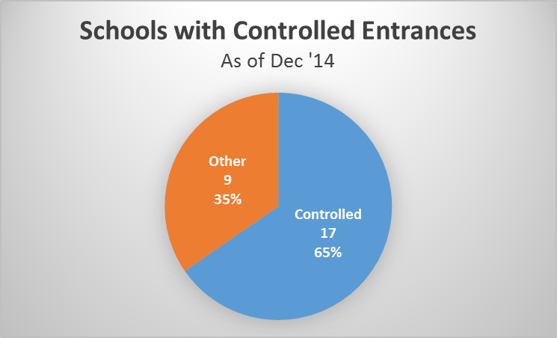
Optimize Resources
5.1 Ensure the Health and Safety of the school community.
D. Tistadt
Summary of Strategies / Actions
  5.1.1 Sustain effective practices from the Safe Schools / Healthy Students Grant.
School Counselors Work Group has been formed to review the grant and identify practices to sustain. (Priority 3.1)
  5.1.2 Implement best practices in K-12 security and safety to include enacting the governor’s safety task force directives and policies.
  Updated school entrances for better security and control.
  Results of continuing CPTED surveys are being used to make changes at schools such as bush and tree trimming to improve visibility.
  Tabletop exercises are starting to be conducted to test school’s crisis plans. The first tabletop was conducted at Monticello HS with additional exercises planned for Cale and Greer Elementary Schools.
  5.1.3 Assess and improve our health services and education.
  Implemented the Be Well Albemarle program and developed School Wellness Champions.
Analysis of Performance Indicators
  17/26 schools have controlled entrances
  We will monitor the completion of controlled entrance projects, CPTED survey recommendations, and tabletop exercises.
Next Steps
  Adjust strategies based on some initiatives not being funded.
  Conduct a needs assessment of health services and education for students and employees.
July ‘14 Impact Assessment Score: 4

Slide 19
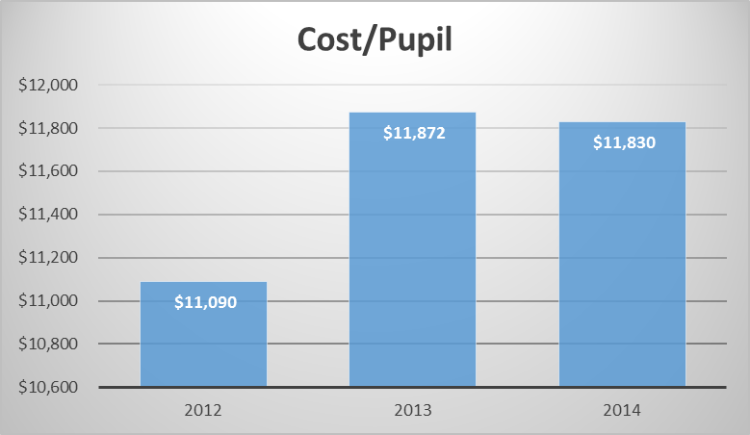
Optimize Resources
5.2 Optimize the use of fiscal resources in support of the Division’s Strategic Plan and Operations.
D. Tistadt
Summary of Strategies / Actions
  5.2.1 Update Budget Processes to ensure alignment of budget, strategies, and operations. - COMPLETE
Process and procedures have been put in place to ensure that budget initiatives are aligned with the Horizon 2020 Strategic Plan and that all documents include language that relates specific funding requests to specific objectives and strategies within the plan.
5.2.2 Conduct program evaluations to determine actual costs and program efficacy. Report findings to the Superintendent and the School Board to help inform decisions regarding resources. The first evaluation is being presented to the School Board on December 11, 2014.
Analysis of Performance Indicators
  The National Center for Educational Statistics reports that the national average for expenditure per student is projected at $12,281 for the 2014–15 school year.
Next Steps
  Refine fidelity measures (KPI) for operational impact of Programs.
  Establish schedule of program evaluations.
  Benchmark ACPS cost per pupil to other school systems.
July ‘14 Impact Assessment Score: 3

Slide 20
Optimize Resources
5.3 Design the High School of the Future.
M. Haas
Summary of Strategies / Actions
  Redefined High School of the Future design to be about identifying, piloting, and evaluating high quality practices that reflect a future vision of the high school experience. The High School Council identifies significant issues relevant to the high schools, and researches and make recommendations for potential systematic implementation in partnership with the Innovation Team (Priority 1.1).
  5.3.1 Alternate Culminating Assessment Pilot – End of Course 2014-15 – High School Only
  A culminating assessment at the end of a course provides students the opportunity to reflect on the content of the curriculum by synthesizing, applying, and analyzing course material.
  Teachers who wanted to participate in the pilot program had to Opt-In prior to the start of the school year. The culminating assessment will count as the exam grade in the course.
  Teachers have the flexibility to determine the format of the culminating assessment, appropriate to the course content of their classes as well as the level of their students.
  5.3.2 Internship & Experiences- School-based teams will work to implement strategies to expand and increase fieldwork opportunities for students and share strategies and results of new efforts. (in conjunction with Priority 4.1)
Analysis of Performance Indicators
  The product of this priority is the Pilot Program Evaluations and Recommendations.
Next Steps
  Joint Session of HS Council and County Student Advisory Council – Discussion of current initiatives as well as the following topics:
  Student stress and workload (Priority 5.1)
  Learning spaces (Priority 1.3)
  Integration of instructional technology (Priority 1.3)
Board Work Session

Slide 21
Next Step
  Use the “How might we?” questions provided or develop some of your own to think about how to further define the Vision for each Priority.
What is our Wow Factor?
Ensure that every student is taking advantage of the opportunities provided?
Support students to own their own learning?
Provide equitable opportunities to all students?
Capitalize on the talents of the ACPS Community to support student mastery of Lifelong Learning Competencies?
Create experiences that are both memorable and valuable?
Notes:
Within this deceptively simple phrase each word plays a powerful role in spurring creative problem-solving.
“How” assumes that solutions exist and provides the creative confidence needed to identify and solve for unmet needs.
“Might” says that we can put ideas out there that might work or might not—either way, we’ll learn something useful.
“We” signals that we’re going to collaborate and build on each other’s ideas to find creative solutions together.

Slide 22
Unleashing Each Student’s Potential

